Slide 1
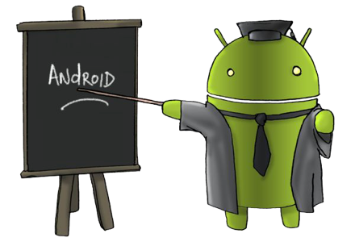
ANDROID

Slide 2
INTRODUCTION
Android is a mobile operating system (OS) based on the Linux kernel and currently developed by Google. With a user interface based on direct manipulation.
Android is designed primarily for touchscreen mobile devices such as smartphones and tablet computers, with specialized user interfaces for televisions (Android TV), cars (Android Auto), and wrist watches (Android Wear).
The OS uses touch inputs that loosely correspond to real-world actions, like swiping, tapping, pinching, and reverse pinching to manipulate on-screen objects, and a virtual keyboard.

Slide 3
HISTORY OF ANDROID
Android, Inc. was founded in Palo Alto, California in October 2003 by Andy Rubin (co-founder of Danger),Rich Miner (co-founder of Wildfire Communications, Inc.), Nick Sears (once VP at T-Mobile) and Chris White (headed design and interface development at WebTV).
Google marketed the platform to handset makers and carriers on the promise of providing a flexible, upgradable system.
Google had lined up a series of hardware component and software partners and signaled to carriers that it was open to various degrees of cooperation on their part.

Slide 4
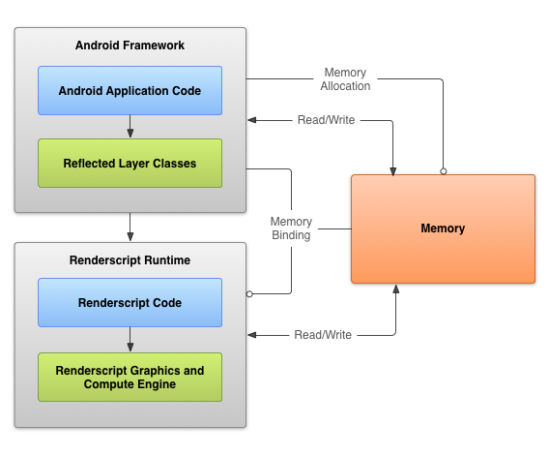
ANDROID FRAMEWORK

Slide 5
ANDROID VERSION HISTORY
Gingerbread (2.3–2.3.7)
Honeycomb (3.0–3.2.6)
Ice Cream Sandwich (4.0–4.0.4)
Jelly Bean (4.1–4.3.1)
Kit Kat(4.4–4.4.4)
Lollipop (5.0.1 – 5.0.2)
Alpha (1.0)
Beta (1.1)
Cupcake (1.5)
Donut (1.6)
Eclair (2.0–2.1)
Froyo (2.2–2.2.3)

Slide 6
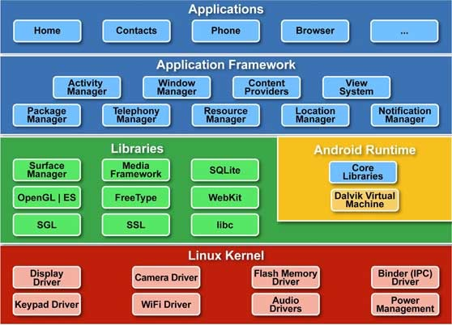
ANDROID ARCHITECTURE

Slide 7
APPLICATION COMPONENTS
Application components are the essential building blocks of an Android application.
These components are loosely coupled by the application manifest file AndroidManifest.xml that describes each component of the application and how they interact.

Slide 8
FOUR MAIN COMPONENTS
Components | Description
Activities | They dictate the UI and handle the user interaction to the smartphone screen
Services | They handle background processing associated with an application.
Broadcast Receivers | They handle communication between Android OS and applications.
Content Providers | They handle data and database management issues.

Slide 9
FEATURES OF ANDROID
Near Field Communication (NFC)
Alternate Keyboards
Infrared Transmission
No-Touch Control
Automation
Wireless App Downloads
Storage and Battery Swap
Custom Home Screens
Widgets
Custom ROM’s

Slide 10
CONCLUSION
Android is a much more diverse operating system than iOS and Windows Phone Mobile.
Android has grown rapidly over the past 4 years becoming the most used smartphone operating system in the world.
It's because Android doesn't release 1 phone from 1 company with 1 new OS every year, but countless phones from numerous companies, adding their own twist, throughout the year, developing gradually day-by-day.
Android's ability to customize is unparalleled compared to Apple's and Microsoft's software allowing the user to change and customize nearly every aspect of Android which most iPhone and Windows 7 users wouldn't dream possible.
Android is better or worse than one OS, but is unique and incomparable to other mobile operating systems.

Slide 11
THANK YOU
www.playppt.com

