Slide 1
BASIC JAVA PROGRAMMING TUTORIAL

Slide 2
History
James Gosling and Sun Microsystems
Oak
Java, May 20, 1995, Sun World
Hot Java
The first Java-enabled Web browser
JDK Evolutions

Slide 3
JDK Editions
Java Standard Edition (J2SE)
J2SE can be used to develop client-side standalone applications or applets.
Java Enterprise Edition (J2EE)
J2EE can be used to develop server-side applications such as Java servlets and Java Server Pages.
Java Micro Edition (J2ME).
J2ME can be used to develop applications for mobile devices such as cell phones.

Slide 4
Java isn't C!
In C, almost everything is in functions
In Java, almost everything is in classes
There is often only one class per file
There must be only one public class per file
The file name must be the same as the name of that public class, but with a .java extension

Slide 5
Why Java?
It’s the current “hot” language
It’s almost entirely object-oriented programming
It has a vast library of predefined objects and operations
It’s more platform independent
-this makes it great for Web programming
It’s more secure
It isn’t C++

Slide 6
Java Virtual Machine
The .class files generated by the compiler are not executable binaries
so Java combines compilation and interpretation
Instead, they contain “byte-codes” to be executed by the Java Virtual Machine
other languages have done this, e.g. UCSD Pascal
This approach provides platform independence, and greater security

Slide 7
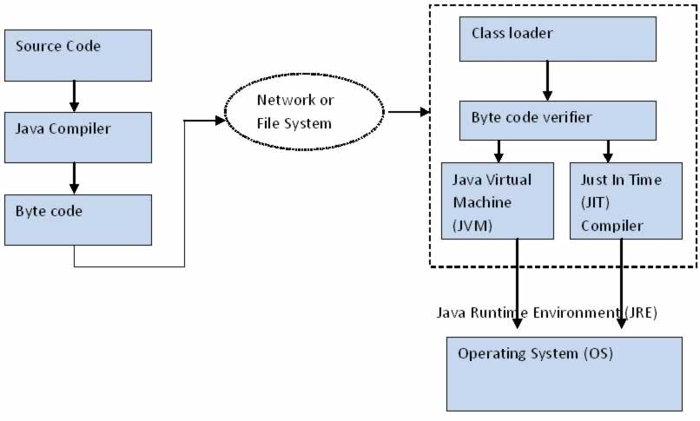
A Picture is Worth…

Slide 8
Java Applications and Java … lets
Stand-alone Applications
Just like any programming language
Applet
Run under a Java-Enabled Browser
Midlet
Run in a Java-Enabled Mobile Phone
Servlet
Run on a Java-Enabled Web Server.

Slide 9
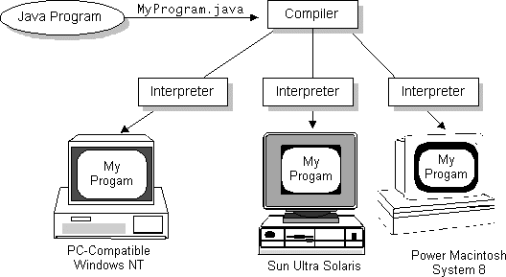
Write Once, Run Anywhere

Slide 10
Main OOP Concepts:
Inheritance
Abstraction
Encapsulation
Polymorphism
Event-driven computations

Slide 11
Characteristics of Java
Java is simple
Java is object-oriented
Java is distributed
Java is interpreted
Java is robust
Java is secure
Java is architecture-neutral
Java is portable
Java’s performance
Java is multithreaded
Java is dynamic

Slide 12
What is a class?
A class consists of
a collection of fields, or variables, very much like the named fields of a struct
all the operations (called methods) that can be performed on those fields
can be instantiated
A class describes objects and operations defined on those objects

Slide 13
Method Declarations
General format of method declaration: return-value-type method-name( parameter1, parameter2, …, parameter N ) { declarations and statements }
Method can also return values:
return expression;

Slide 14
An example of a class and methods
class classname { Datatypes variable;
Method // returntype methodname ( ) { } }

Slide 15
The “Welcome to java” Application

Slide 16
A Simple Application
Example
//This application program prints Welcome
//to Java
public class Welcome {
public static void main(String[] args) {
System.out.println(“Welcome to Java");
}
}

Slide 17
Running Welcome
To compile Welcome.java, use the compiler. If successful, it will produce a file called Welcome.class in the same directory.
> javac Welcome.java
[ compiler output ]
To execute, run the Java VM and include the name of the class which contains the "main" method as the first command line parameter.
> java Welcome
Welcome to java

Slide 18
Thank You
www.playppt.com

