Slide 1
Ethical Hacking

Slide 2
What is Ethical Hacking?
Ethical hacking are terms used to describe hacking performed by a company or individual to help identify potential threats on a computer or network.
An ethical hacker attempts to bypass way past the system security and search for any weak points that could be exploited by malicious hackers.
This information is then used by the organization to improve the system security, in an effort to minimize or eliminate, any potential attacks.

Slide 3
What Constitutes Ethical Hacking?
In order for hacking to be deemed ethical, the hacker must obey the following rules:
Expressed (often written) permission to probe the network and attempt to identify potential security risks.
You respect the individual's or company's privacy.
You close out your work, not leaving anything open for you or someone else to exploit at a later time.
You let the software developer or hardware manufacturer know of any security vulnerabilities you locate in their software or hardware if not already known by the company.

Slide 4
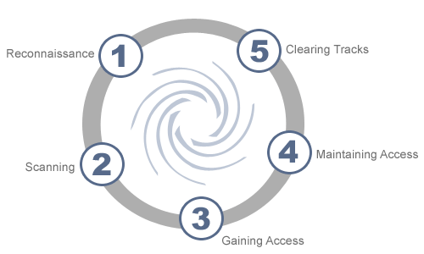
Phases of Hacking

Slide 5
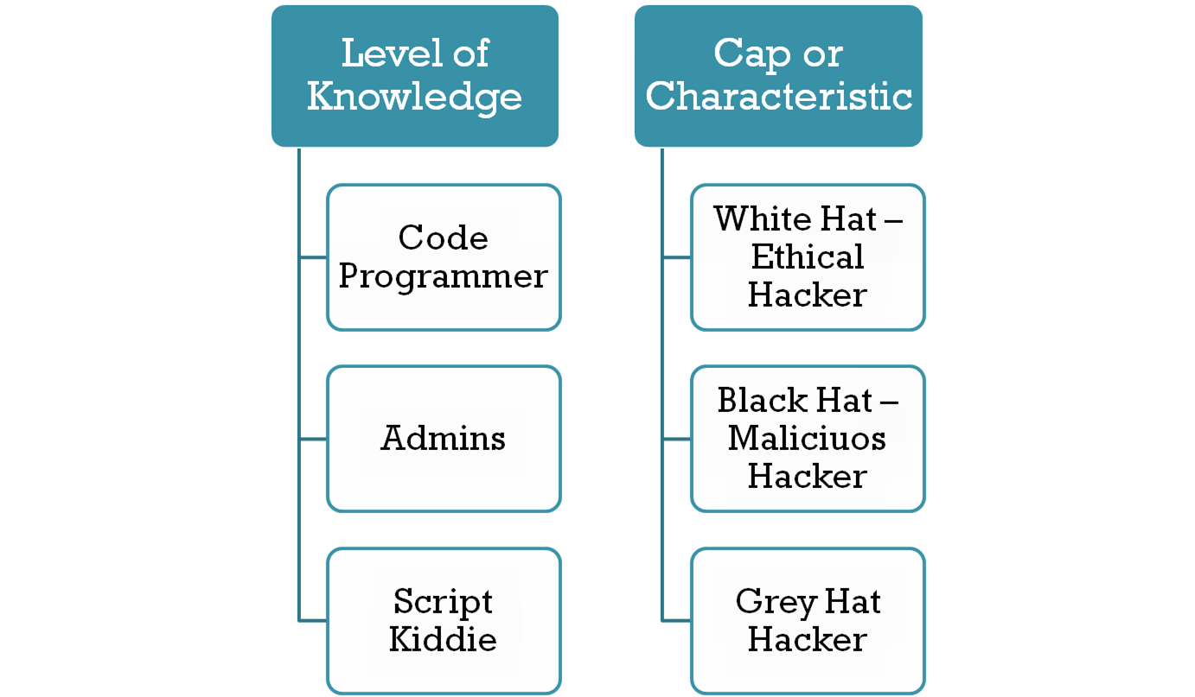
Types of Hackers and Testers
Hacktivists
Cyberwarrior
Black Box Penetration Testers
White Box Penetration Testers

Slide 6
Hacktivists
Hacktivism is hacking into a computer system illegally for a social or politically motivated reason.
These hackers could just leave a large message on the main page of a website, or even disrupt traffic to a site altogether.

Slide 7
Cyberwarrior
This is another gray area of ethical hacking.
Whether or not this type of hacking is ethical is all in the eye of the beholder.
Cyberwarriors are computer experts and hackers who participate in cyberwarfare, which are actions undertaken or sanctioned by a nation-state to infiltrate another country's networks or computers to cause disruption or damage.

Slide 8
Black Box Penetration Testers
This is a hacker who is hired by a person or company to actually infiltrate a computer network or system.
The hacker will act as a malicious hacker, trying to find vulnerabilities in a system or network that would allow him to attack it.
The black box penetration tester has no prior knowledge of the network or system he is trying to infiltrate.
By finding vulnerabilities, he can advise the company of individual about what is needed to strengthen a website from future hacking.

Slide 9
White Box Penetration Testers
This is another type of hacker that is hired by a person or company to break into a computer network or system.
The white box hacker is much like the black box hacker in that they both are legally breaking into these systems in an effort to help the person or company who hires them.
The only difference between the two is that white box penetrators are given complete knowledge of the system or network they are infiltrating.
The hacker simulates an attack from an insider of the organization.

Slide 10
How to Do Ethical Hacking?
So first you should be very patient with this and try not to do anything too stupid and get yourself in trouble. Keep in mind that this does not come instantly, it comes over years of practice.
Learn how to code
Learn how to use the command prompt
Act like a hacker
When you learn how to program, the best thing to hack is yourself
Communicate with other hackers

Slide 11
Future Works with Recommendations
The websites and internet networks are being secured now days in many e-businesses.
As the customers are suspicious in trusting the organizations on behalf of their personal credit cards and information, the organization professional are considering the future works.
Recommendations also included for the future analysis of the ethical hacking. The information of the trusted customers and other users should be secured from the hackers and other attacks.
The detection and prevention of the attacks of ethical hacking and its trend makes the future work efficient.

Slide 12
THANK YOU
www.playppt.com

