Slide 1
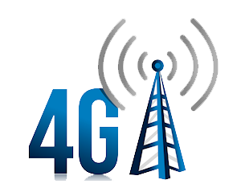
4G BROADBAND
WWW.PLAYPPT.COM

Slide 2
BROADBAND
Broadband is the marketing term for wireless Internet access through a portable modem, mobile phone, USB wireless modem, tablet or other mobile devices.
The first wireless Internet access became available in 1991 as part of the second generation (2G) of mobile phone technology.
Higher speeds became available in 2001 and 2006 as part of the third (3G) and fourth (4G) generations.
In 2011, 90% of the world's population lived in areas with 2G coverage, while 45% lived in areas with 2G and 3G coverage.

Slide 3
INTRODUCTION
While 3G hasn't quite arrived, designers are already thinking about 4G technology.
Cellular service providers are slowly beginning to deploy third-generation (3G) cellular services.
As access technology increases, voice, video, multimedia, and broadband data services are becoming integrated into the same network.
It is apparent that 3G systems , while maintaining the possible 2-Mbps data rate in the standard, will realistically achieve 384 kbps rates.
To achieve the goals of true broadband cellular service, the systems have to make the leap to a fourth generation (4G) network.

Slide 4
WHAT IS 4G?
4G, short for fourth generation, is the fourth generation of mobile telecommunications technology, succeeding 3G and preceding 5G.
A 4G system, in addition to the usual voice and other services of 3G, provides mobile broadband Internet access.
For example to laptops with wireless modems, to smart phones, and to other mobile devices.
Potential and current applications include amended mobile web access, IP telephony, gaming services, high-definition mobile TV, video conferencing, 3D television, and cloud computing.

Slide 5
VISION OF 4G
This new generation of wireless is intended to complement and replace the 3Gsystems, perhaps in 5 to 10 years.
The future 4G infrastructures will consist of a set of various networks using IP as a common protocol so that users are in control environment.
The 4G systems will interoperate with 2G and 3G systems, as well as with digital (broadband) broadcasting systems.
In addition, 4G systems will be fully IP-based wireless Internet.
With 4G, a range of new services and models will be available These services and models need to be further examined for their interface with the design of 4G systems.

Slide 6
FEATURES OF 4G
4G refers to the fourth generation of cellular wireless standards. It is a successor to3G and2G families of standards.
A 4G system is expected to provide a comprehensive and secure all-IP based solution where facilities such as IP telephony, ultra-broadband.
4G is being developed to accommodate the Quos and rate requirements set by further development of existing 3G applications like mobile broadband access.
Multimedia Messaging Service(MMS),video chat, mobile TV, but also new services like HDTV.
4G may allow roaming with wireless local area networks, and may interact with digital video broadcasting systems

Slide 7
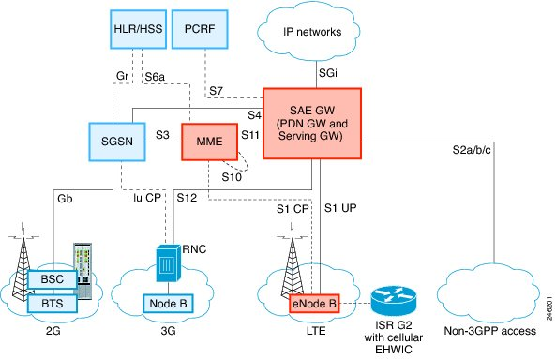
4G ARCHITECTURE

Slide 8
KEY 4G TECHNOLOGIES
Some of the key technologies required for 4G are briefly described below:
OFDMA: ORTHOGONAL FREQUENCY DIVISION MULTIPLEXING.
SDR: SOFTWARE DEFINED RADIO.
MIMO: MULTIPLE INPUT MULTIPLE OUTPUT

Slide 9
4G CHALLENGES
Analysis of the underlying technical challenges raised by the above vision and its five elements has produced three research areas:
Networks and services
Software based systems
Wireless access

Slide 10
NETWORKS & SERVICES
The aim of 3G is ‘to provide multimedia multi rate mobile communications any time and anywhere’, though this aim can only be partially met.
It will be uneconomic to meet this requirement with cellular mobile radio only.
4G will extend the scenario to an all-IP network (access + core) that integrates broadcast, cellular, cordless, WLAN(wireless local area network), short-range systems and fixed wire.
The vision is of integration across these network air interfaces and of a variety of radio environments on a common, flexible and expandable platform — a ‘network of networks’ with distinctive radio access connected to a seamless IP-based coronet work.

Slide 11
SOFTWARE BASED SYSTEMS
The aim of the research in this area is to develop tools that can be used in 4G software systems:
E-commerce, including micro transactions, share trading and internal business transactions
Home services, ranging from terminal enhancements to security systems and housekeeping tasks
Transportation systems: Itinerary support, ticketing and location services are to be targeted in this area.
Infotainment on the move: This will demonstrate the need for software and terminal reconfiguration and media-adaptation.
Telemedicine and assistance services: Emergency team support, remote/virtual operations and surveillance of heart patients are possible stages for this scenario

Slide 12
WIRELESS ACCESS
The radio part of the 4G system will be driven by the different radio environments.
Thus the drivers are:
Adaptive re-configurability - algorithms
Spectral efficiency - air interface design and allocation of bandwidth
Environment coverage - all pervasive
Software - for the radio and the network access
Technology - embedded / wearable / low-power / high communication time / displays

Slide 13
CONCLUSION
It is always dangerous to predict too far ahead in a fast- moving field such as mobile communications.
Almost by definition the eventual 2010 scene will not match exactly that depicted in the 4G vision described here in.
The 4G Vision is a living document which intends to update and amend as time and knowledge progress.
It will act as the umbrella vision to a large research programmer and place in context the detailed research work that will take place in the various areas.
In this respect it will help to continuously steer the research as it progresses and, therefore, to make it more relevant and beneficial.

Slide 14
THANK YOU!!
www.playppt.com

