Slide 1
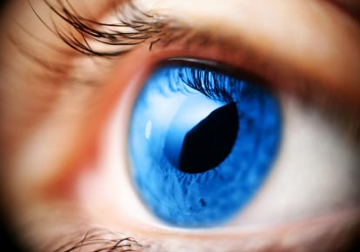
Eye Movement Based Human Computer

Slide 2
INTRODUCTION
An eye tracking system records how the eyes move when a subject is sitting in front of a computer screen.
The human eyes are constantly moving until they stop and focus on a point.
There are over ten different types of eye movements, of which the most important ones are saccades and fixations.
When the eyes focus on a point, it is called a fixation and the movements between these fixations are called saccades.
When the eye fixates, the stops vary from about 100 to 600 milliseconds and during this stop the brain starts to process the visual information received from the eyes.

Slide 3
TECHNOLOGIES
The most widely used current designs are video-based eye trackers.
A camera focuses on one or both eyes and records their movement as the viewer looks at some kind of stimulus.
Most modern eye-trackers use the center of the pupil and infrared / near-infrared non-collimated light to create corneal reflections (CR).
The vector between the pupil center and the corneal reflections can be used to compute the point of regard on surface or the gaze direction.
A simple calibration procedure of the individual is usually needed before using the eye tracker

Slide 4
TECHNIQUES
Two general types of eye tracking techniques are used:
Bright-pupil
Dark-pupil
Their difference is based on the location of the illumination source with respect to the optics.
Bright-pupil tracking creates greater iris/pupil contrast, allowing more robust eye tracking with all iris pigmentation, and greatly reduces interference caused by eyelashes and other obscuring features.
It also allows tracking in lighting conditions ranging from total darkness to very bright.

Slide 5
TRACKER TYPES
Eye trackers measure rotations of the eye in one of several ways, but principally they fall into three categories:
Measurement of the movement of an object (normally, a special contact lens) attached to the eye.
Optical tracking without direct contact to the eye.
Measurement of electric potentials using electrodes placed around the eyes.

Slide 6
HCI

Slide 7
EYE-ATTACHED TRACKING
The first type uses an attachment to the eye, such as a special contact lens with an embedded mirror or magnetic field sensor.
The movement of the attachment is measured with the assumption that it does not slip significantly as the eye rotates.
Measurements with tight fitting contact lenses have provided extremely sensitive recordings of eye movement.
Magnetic search coils are the method of choice for researchers studying the dynamics and underlying physiology of eye movement.
It allows the measurement of eye movement in horizontal, vertical and torsion directions

Slide 8
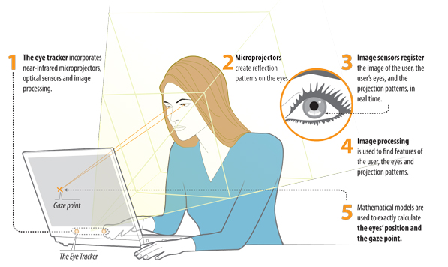
WHAT IS EYE TRACKER?

Slide 9
OPTICAL TRACKING
The second broad category uses some non-contact, optical method for measuring eye motion.
Light, typically infrared, is reflected from the eye and sensed by a video camera or some other specially designed optical sensor.
The information is then analyzed to extract eye rotation from changes in reflections.
Video-based eye trackers typically use the corneal reflection and the center of the pupil as features to track over time.
A still more sensitive method of tracking is to image features from inside the eye, such as the retinal blood vessels, and follow these features as the eye rotates.

Slide 10
ELECTRIC POTENTIAL MEASUREMENT
The third category uses electric potentials measured with electrodes placed around the eyes.
The eyes are the origin of a steady electric potential field, which can also be detected in total darkness and if the eyes are closed.
It can be modeled to be generated by a dipole with its positive pole at the cornea and its negative pole at the retina.
The electric signal that can be derived using two pairs of contact electrodes placed on the skin around one eye is called Electrooculogram (EOG).
If the eyes move from the centre position towards the periphery, the retina approaches one electrode while the cornea approaches the opposing one.

Slide 11
EYE TRACKING AS AN INPUT DEVICE
Eye movements can be measured and used to enable an individual actually to interact with an interface.
Users could position a cursor by simply looking at where they want it to go, or “click” an icon by gazing at it for a certain amount of time or by blinking.
The first obvious application of this capability is for disabled users who cannot make use of their hands to control a mouse or keyboard (Jacob & Karn, 2003).
However, intention can often be hard to interpret; many eye movements are involuntary, leading to a certain “Midas Touch”.

Slide 12
FUTURE TRENDS IN EYE TRACKING
Future developments in eye tracking should centre on standardizing what eye movement metrics are used.
How they are referred to, and how they should be interpreted in the context of interface design.
Once eye tracking achieves these improvements in technology, methodology, and cost.
Data collection, filtering and -analysis software should be streamlined so that they can work together without user intervention
It can take its place as part of a standard HCI toolkit.

Slide 13
CONCLUSION
Our contention is that eye-movement tracking represents an important.
Objective technique that can afford useful advantages for the in-depth analysis of interface usability.
Eye-tracking studies in HCI are beginning to burgeon, and the technique seems set to become an established.
In addition to the current battery of usability-testing methods employed by commercial and academic HCI researchers.

Slide 14
THANK YOU
www.playppt.com

