Slide 2
What is Hadoop?
Hadoop is an open-source software framework for storing and processing big data in a distributed fashion on large clusters of commodity hardware.
It is designed to scale up from a single server to thousands of machines with very high degree of fault tolerance.
Essentially, it accomplishes two tasks:
Massive data storage
Faster processing

Slide 3
Hadoop overview
Apache Software Foundation project
Framework for running applications on large clusters
Modeled after Google’s MapReduce / GFS framework
Implemented in Java
It Includes
HDFS - a distributed file system
Map/Reduce - offline computing engine
Recently: Libraries for ML and sparse matrix comp.

Slide 4
Hadoop Architecture
At its core, Hadoop has two major layers namely:
Processing/Computation layer - (MapReduce)
Storage layer - (Hadoop Distributed File System).

Slide 5
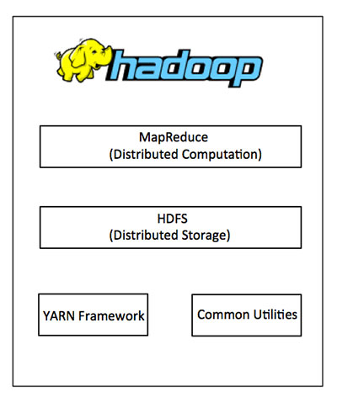
HADOOP ARCHITECTURE

Slide 6
MapReduce
MapReduce is a parallel programming model for writing distributed applications devised at Google for efficient processing of large amounts of data (multi-terabyte data-sets).
The large clusters (thousands of nodes) of commodity hardware in a reliable, fault-tolerant manner.
The MapReduce program runs on Hadoop which is an Apache open-source framework.

Slide 7
Hadoop Distributed File System
Fault tolerant, scalable, distributed storage system
Designed to reliably store very large files across machines in a large cluster.
Data Model
Data is organized into files and directories
Files are divided into uniform sized blocks and distributed across cluster nodes
Blocks are replicated to handle hardware failure
HDFS exposes block placement so that computes can be migrated to data.

Slide 8
Hadoop Cluster
A Hadoop cluster is a special type of computational cluster designed specifically for storing and analyzing.
In a huge amounts of unstructured data in a distributed computing environment.
Hadoop clusters are known for boosting the speed of data analysis applications.
Hadoop clusters also are highly resistant to failure because each piece of data is copied onto other cluster nodes, which ensures that the data is not lost if one node fails.

Slide 9
Why use Hadoop?
Hadoop changes the economics and the dynamics of large-scale computing.
Its impact can be boiled down to four salient characteristics.
Scalable
Cost effective
Flexible
Fault tolerant

Slide 10
Advantages of Hadoop
Hadoop framework allows the user to quickly write and test distributed systems.
Hadoop does not rely on hardware to provide fault-tolerance and high availability (FTHA), rather Hadoop library itself has been designed to detect and handle failures at the application layer.
Servers can be added or removed from the cluster dynamically and Hadoop continues to operate without interruption.
Another big advantage of Hadoop is that apart from being open source, it is compatible on all the platforms since it is Java based.

Slide 11
THANK YOU
www.playppt.com

