Slide 1
Basic Concepts
Of CITRIX XENAPP

Slide 2
WHAT IS CITRIX XENAPP?
Citrix XenApp is a product that extends Microsoft Remote Desktop Session Host desktop sessions and applications to users via the Citrix HDX protocol.
Citrix XenApp and Remote Desktop Services allow Windows applications and computing resources to be centrally managed in a secure data center.
Users can access the applications from anywhere and from non-Windows clients.

Slide 3
SERVER COMPONENTS
The Citrix Developer Network contains a set of software development kits that enable custom development for XenApp.
These SDKs include the following:
Citrix XenApp SDK
Citrix Virtual Channel SDK
Citrix ICA Client Object SDK
Citrix Web Interface SDK
Citrix Simulation API SDK

Slide 4
CLIENT COMPONENTS
XenApp components, including application hosting servers, if any, reside on a Microsoft Windows computer, which can be either standalone or part of a larger cluster (farm) of Citrix servers.
XenApp components, including application hosting servers, if any, reside on a Microsoft Windows computer, which can be either standalone or part of a larger cluster (farm) of Citrix servers.

Slide 5
XENAPP ENVIRONMENT
A XenApp environment consists of three parts:
Multi-User Operating System
XenApp Software
Client Devices

Slide 6
MULTI-USER OPERATING SYSTEM
Microsoft Windows Server with the Remote Desktop Session Host feature allows multiple users to independently access a server.
Users can connect to individual applications or session-based desktops.

Slide 7
XENAPP SOFTWARE
Citrix XenApp extends the Remote Desktop Services applications and desktops to client devices via the HDX protocol.
HDX provides remote display capabilities, multimedia redirection, USB redirection, and a variety of other capabilities, depending on the client device.

Slide 8
CLIENT DEVICES
XenApp sessions and applications can be accessed by client devices using a software client called Citrix Receiver.
Citrix Receiver is available for a very large array of client form factors and operating systems.

Slide 9
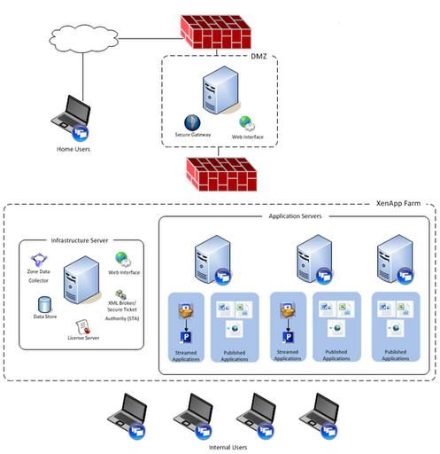
CITRIX XENAPP ARCHITECHTURE

Slide 10
KEY FEATURES
Discovering topology of XenApp farms
monitoring health and state
insight into real end-user experience
historical performance tracking and reports
server and application load tracking

Slide 11
BENEFITS OF XENAPP
Virtualization brings higher availability and faster recovery allowing faster return to normal operations and reducing the impact of failure on the business.
Virtualization can reduce a server instance failure domain, allowing for greater flexibility with updates and again, reducing the business impact on failure.
It is this range of advantages that has driven Citrix XenApp virtualization to be the norm rather than the exception.
That said, there are common issues in moving to a virtualised environment.
With the fortune of benefits, there are slings and arrows best avoided. Sizing storage and performance demand correctly is key.

Slide 12
CONCLUSION
XenApp is making it easier than ever to deliver the apps needed for your complex and increasingly mobile workforce.
Whether you are ready to update today, or planning for the future, the easiest way to experience XenApp is to download it and see for yourself just how simple and powerful it can be.
With intuitive wizards and automated configuration checking, you’ll have an environment up and running in record time.

Slide 13
THANK YOU
www.playppt.com

