Slide 1
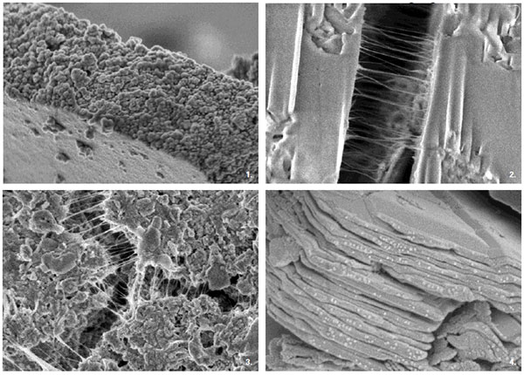

NANO CONCRETE

Slide 2
INTRODUCTION
Concrete is the most widely used man-made material, and the manufacture of cement.
The main ingredient of concrete–accounts for 5 to 10 percent of all anthropogenic emissions of carbon dioxide, a leading greenhouse gas involved in global warming.
Concrete is a highly heterogeneous material produced by mixture of finely powdered cement, aggregates of various sizes and water with inherent physical, chemical and mechanical properties.
A reaction between the cement and water yields calcium silicate hydrate, which gives concrete strength.

Slide 3
NANO CONCRETE AND NANO INGREDIENTS
Nano concrete made with Portland cement in which particle sizes ranging from a few nanometer to a maximum of about 100 micrometers.
Nano ingredients with at least one dimension of nano meter size.
So the particle size has to be reduced in order to obtain Nano-Portland cement.
Further, if these nano-cement particles are processed with nanotubes and reactive nano-size silica particles, then strong, tough, more flexible, cement can be developed with enhanced properties.

Slide 4
SELF HEALING PROCESS IN NANO CONCRETE
Experimentation is also underway on self-healing concrete.
When self-healing concrete cracks, embedded microcapsules rupture and release a healing agent into the damaged region through capillary action.
The released healing agent contacts an embedded catalyst, polymerizing to bond the crack face closed.
In fracture tests, self-healed composites recovered as much as 75 percent of their original strength.
They could increase the life of structural components by as much as two or three times.

Slide 5
NANO SCALE APPORACH
There are two different approaches in nano scale process.
The first one is to form nano scale structure by reducing the size of the structure.
Top-down approach
The other one is to form the desired material by starting from atom and molecule.
Bottom-up approach

Slide 6
NANO STRUCTURE DEVELOPMENT
For the development of nano structures, it should be able
i) to understand the interactions in nanoscale
ii) to see the structures in nanoscale
iii) to form, process, and combine the nano structure.

Slide 7
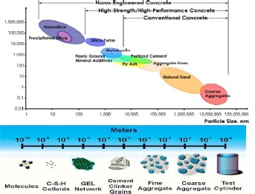
NANO CEMENT AND NANOSILICON

Slide 8
NANOSILICON DI OXIDE
Current research activity in concrete using
nano cement and nano silica includes:
(i) Characterization of cement hydration
(ii) Influence of the addition of nano-size silica to concrete
(iii) Synthesis of cement using nano particles and coatings

Slide 9
THE USE OF NANOPOWDERS IN CONCRETETECHNOLOGY
The use of the powders in concrete technology affects the cement kinetics and accelerates hydration significantly.
It was expressed that larger surface area and stronger electrostatic forces of the powders lead to these changes .
The nano powders, additionally, are not only as filler, but also as an activator to promote hydration.

Slide 10
THE USE OF NANOPOWDERS IN CONCRETETECHNOLOGY
Improve the microstructure of the concrete when they are uniformly dispersed .
Furthermore, it was seen that the mortars produced with the powders have very high capacity, and compressive and bending strength, are more uniform, and more durable for water penetration

Slide 11
CONCLUSION
It is necessary to reduce the size of concrete researches which have been concentrated on macro-structure at the present time, and to control the hydration reactions by nanotechnology.
The properties of concrete are improved by the use of nano powders, and the behavior of concrete is determined by the observation of microstructure with the help of some nano materials which can be defined as nano sensors.

Slide 12
THANK YOU
www.playppt.com

