Slide 1
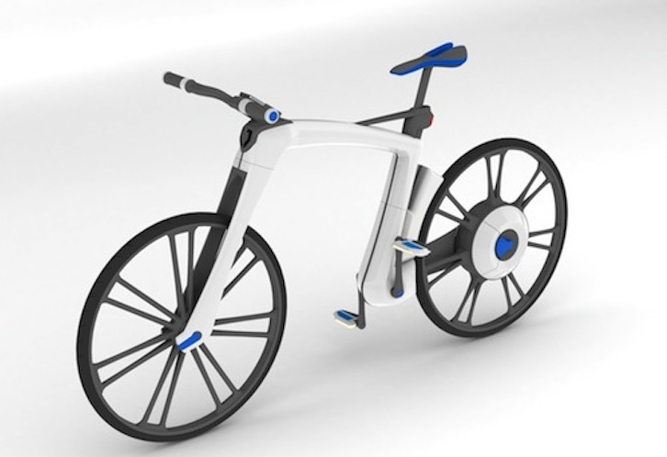
ELECTRIC BICYCLE PPT

Slide 2
INTRODUCTION
An electric bicycle, also known as an e-bike or booster bike, is a bicycle with an integrated electric motor which can be used for propulsion.
There is a great variety of e-bikes available worldwide, from e-bikes that only have a small motor to assist the rider's pedal-power to somewhat more powerful e-bikes which tend closer to moped-style functionality.
E-bikes use rechargeable batteries and the lighter varieties can travel up to 25 to 32 km/h (16 to 20 mph), depending on the laws of the country in which they are sold. While the more high-powered varieties can often do in excess of 45 km/h (28 mph).

Slide 3
ELECTRIC BICYCLES Classification
Despite these legal complications, the classification of e-bikes is mainly decided by whether the e-bike's motor assists the rider using a pedal-assist system or by a power-on-demand one.
Definitions of these are as follows:
Pedal-assist
The electric motor is regulated by pedaling.
The pedal-assist augments the efforts of the rider when they are pedaling.
These e-bikes – called pedelecs – have a sensor to detect the pedaling speed, the pedaling force, or both.
Brake activation is sensed to disable the motor as well.
.

Slide 4
Power-on-demand
The motor is activated by a throttle, usually handlebar-mounted just like on most motorcycles or scooters.
They are also useful when it would be helpful for the riders who more generally need some assistance.
Therefore, very broadly, e-bikes can be classed as:
E-bikes with pedal-assist only
E-bikes with power-on-demand and pedal-assist
E-bikes with power-on-demand only

Slide 5
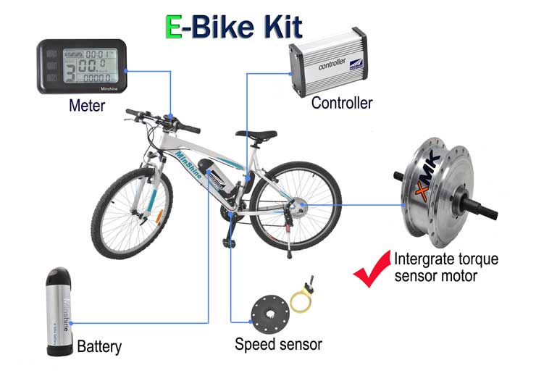

Slide 6
E-bikes with pedal-assist only
It can be clasified into two legal E-bikes
pedelecs (legally classed as bicycles) or
S-Pedelecs (often legally classed as mopeds)
Pedelecs: have pedal-assist only, motor assists only up to a decent but not excessive speed (usually 25 km/h), motor power up to 250 watts, often legally classed as bicycles
S-Pedelecs: have pedal-assist only, motor power can be greater than 250 watts, can attain a higher speed (e.g., 45 km/h) before motor stops assisting, legally classed as a moped or motorcycle (not a bicycle)

Slide 7
E-bikes with power-on-demand and pedal-assist
Some e-bikes combine both pedal-assist sensors as well as a throttle
E-bikes with power-on-demand only
Often have more powerful motors than pedelecs but not always, the more powerful of these are legally classed as mopeds or motorcycles.
With power-on-demand only e-bikes the rider can:
Ride by pedal power alone, i.e. fully human-powered.
Ride by electric motor alone by operating the throttle manually.
Ride using both together at the same time.

Slide 8
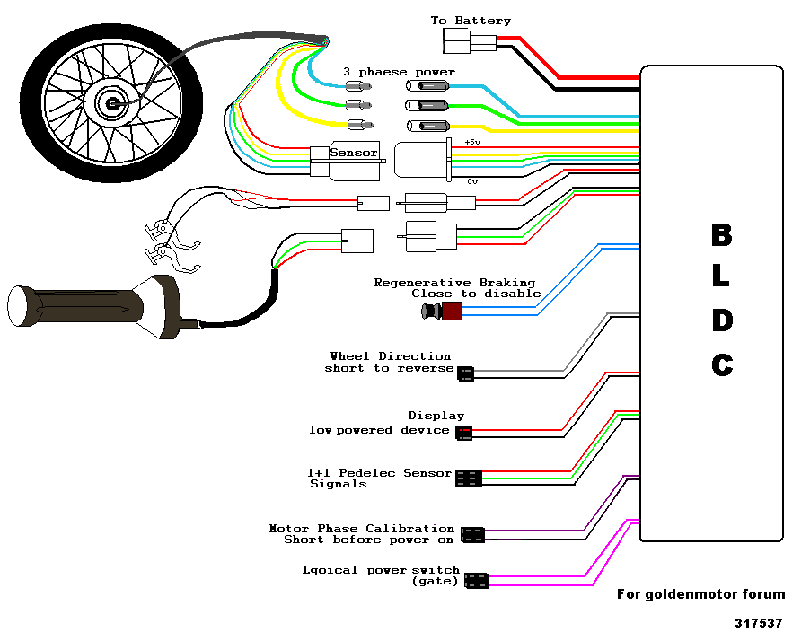
WORKING PROCESS OF ELECTRIC BICYCLE

Slide 9
HEALTH AND FITNESS
Getting into the best shape of your life has never been so fun or easy. From long rides on flat ground to runs up and down gently rolling hills, these bikes will redefine your workout.
If you want to shed extra pounds, an E-Bicycle will help you lose weight safely and without the stressful impact of other activities like jogging.
Riding an E-Bicycle will give you more energy and vitality, making you feel younger while lowering stress levels and improving your overall health.

Slide 10
ADVANTAGES OF ELECTRIC BICYCLES
A main advantage of electric bicycle over motorcycles or mopeds, including electric motorcycles.
In electric bike can use the bicycle infrastructure, park in bicycle areas, ride on sidewalks and bike paths.
This allows for much faster movement in congested downtown areas.
Electric bicycles also allow the rider to pedal and get exercise in time they normally spend commuting.

Slide 11
CONCLUSIONS
The issues associated with electric bicycles may be addressed by custom-designed drives that are most efficient over a given operating cycle.
These include city bicycles, hill bicycles, distance bicycles, and speedy bicycles.
The results of the studies listed here can serve as a platform to improve electric bicycle performance if new drive systems are designed around key parameters that will result in improvement of the system performance.
Furthermore, they can be used for comparison of existing drives in a systematical, comprehensive, and technical way.

Slide 12
THANK YOU
www.playppt.com

