Slide 1
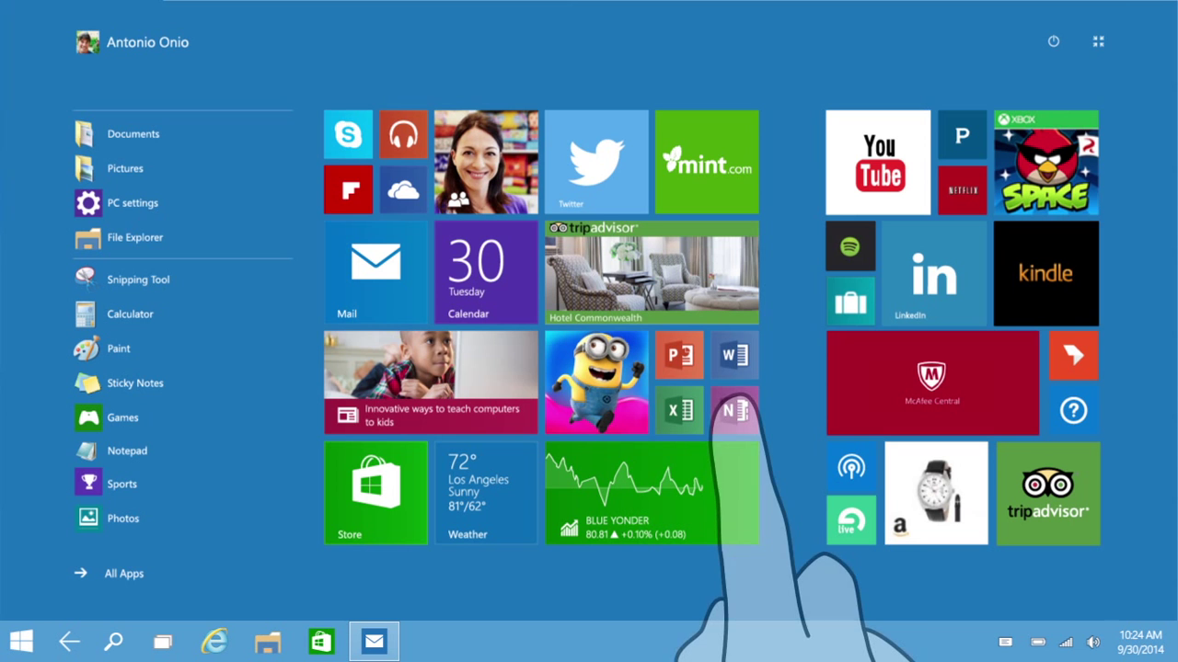
WINDOWS 10 OPERATING SYSTEM

Slide 2
INTRODUCTION
Windows 10's user interface is an evolution of Windows 8's, with a focus on transitioning between behaviors suitable for the type of device and the available input methods.
To improve the experience for keyboard and mouse users, Windows 10 adds a new revision of the desktop.
Start menu and a virtual desktop system, and allows Windows Store apps to run within windows on the desktop as well as in full-screen mode.
The operating system will introduce new technologies and system components, including DirectX 12 and new frameworks for biometric authentication.

Slide 3
EVOLUTION OF WINDOWS 10
The goal of Windows 10 is to unify Windows PC, Windows Phone, Windows Embedded and Xbox.
One product families, as well as new product categories such as the Surface Hub and HoloLens, around a common internal core.
These products will share a common, "universal" application architecture and Windows Store ecosystem that expands upon the Windows Runtime platform introduced by Windows 8.
Windows 10 will also introduce a new bundled web browser, Microsoft Edge, to replace Internet Explorer.

Slide 4
WINDOWS 10 RELEASE
Windows 10 will launch in late-2015, likely by the end of July.
The Technical Preview will end on 15 April 2015. Microsoft also debuted the 84in Microsoft Surface Hub and Windows Holographic.
The latter will allow users to create 3D models via a custom-built HoloLens

Slide 5
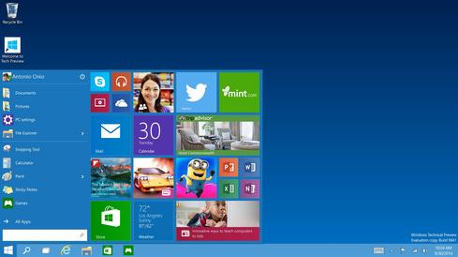
START MENU
Windows 10 gives users a Start menu that looks similar to pre-Windows 8 versions of Windows.
The Start button is available in the taskbar at the bottom or the top-left corner of the screen, depending on the taskbar orientation the user chooses.

Slide 6
USER INTERFACE AND DESKTOP
Windows 10's user interface changes its behavior depending on the type of device being used and available input methods.
A new feature called Continuum handles transitions between interface modes on convertible laptops and tablets with docking keyboards.
A new virtual desktop system known as Task View was added.
Windows Store apps, which previously could only be used full-screen, can now be used in desktop windows or full-screen mode.

Slide 7
MULTIPLE DESKTOPS
Microsoft has declined to support the feature in its desktop operating systems until now.
The introduction of the Start screen in Windows 8 seemed to confirm that the Windows organizational strategy was focused on better single desktop management.
In Windows 10, you can simply add or remove new desktop environments, and open programs in them when you do.

Slide 8
MULTIMEDIA AND GAMING
Windows 10 will provide heavier integration with the Xbox ecosystem:
An updated Xbox app allows users to browse their game library (including both PC and Xbox console games)
Windows 10 will also allow users to control and play games from an Xbox One console over a local network.
An Xbox Live SDK will allow application developers to incorporate Xbox Live functionality into their apps, and future wireless Xbox One accessories (such as controllers) will be supported on Windows with an adapter

Slide 9
FEATURES
The Windows Store app ecosystem has been revised into "Windows apps".
Single platform for smartphones, tablets, and PCs
Return of Start menus
New browser, code-named Spartan
Multiple desktops
Cortana personal assistant for desktops
A major aspect of Windows 10 is a focus on harmonizing user experiences and functionality between different classes of devices.
Along with addressing shortcomings in the Windows user interface that was first introduced in Windows 8.

Slide 10
SYSTEM AND SECURITY
Windows 10 will incorporate multi-factor authentication technology based upon standards developed by the FIDO Alliance.
The operating system includes improved support for biometric authentication through the "Windows Hello" and "Passport" platforms.
The devices with supported cameras (requiring infrared illumination) will allow users to login with face or iris recognition, similarly to Kinect.
Fingerprint recognition login is also available on devices with supported readers. Credentials are stored locally and protected using asymmetric encryption.

Slide 11
CONCLUSION
Whatever your feelings are about Microsoft and the ubiquitous Windows OS, it’s clear that they listened to their users when building Windows 10.
There’s a return to focusing on the user experience at all levels, rather than the Start screen that turned so many power users off of Windows 8.
The classic layout, return of the Start menu, and other features provide an experience that feels much more familiar to users of Windows 7 and XP.
Windows 10 will please everyone, from the most basic computer users, to the biggest enthusiasts, and everyone in between.

Slide 12
THANK YOU
www.playppt.com

