Slide 1
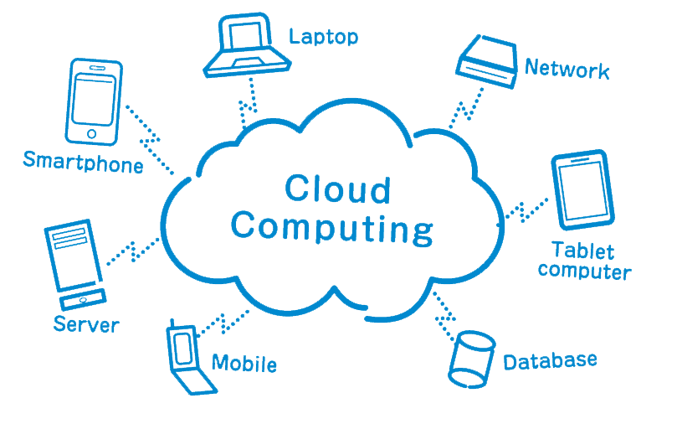
Cloud computing
www.playppt.com

Slide 2
What is cloud computing?
Cloud Computing, also known as ‘on-demand computing’, is a kind of Internet-based computing, where shared resources, data and information are provided to computers and other devices on-demand.
In cloud computing, the word cloud is used as a metaphor for ‘the internet’, so the phrase cloud computing means ‘a type of Internet-based computing’.

Slide 3
Why cloud computing?

Slide 4
Architecture
Cloud architecture, the systems architecture of the software systems involved in the delivery of cloud computing.
It typically involves multiple cloud components communicating with each other over a loose computing mechanism such as a messaging queue.
Elastic provision implies intelligence in the use of tight or loose coupling as applied to mechanisms such as these and others.

Slide 5
Sample architecture

Slide 6
Services
Software as a service (SaaS)
Runs on distant computers “in the cloud” that are owned and operated by others and that connect to users computers via the internet.
Platform as a service (PaaS)
Supports the complete lifecycle of building and delivering cloud applications without the cost and complexity of buying and managing the underlying hardware, software, provisioning and hosting.
Infrastructure as a service (IaaS)
Provides companies with computing resources including servers, networking, storage and data center space on a pay-per-use basis.

Slide 7
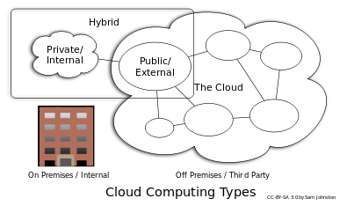
Deployment models
Private Cloud
Public Cloud
Hybrid Cloud
Others
Community Cloud
Distributed Cloud
Intercloud
Multicloud

Slide 8
Key Characteristics
Agility
Cost
Maintenance
Multitenancy
Centralization
Peak-load Capacity
Utilization and Efficiency
Device and Location Independence
Performance
Productivity
Reliability
Scalability and Elasticity
Security

Slide 9
Security
Is Cloud Computing Safe?
Answer: No.
The reason why is everything that cloud computing is based on is mechanical, although it seems virtual.
The safety of the data is only as safe as the will and determination of the individual that wants to have at it.

Slide 10
Disaster Recovery
Cloud Computing ideal as a Disaster Recovery solution?
Answer: Yes.
As with any disaster recovery solution for a business you should have both an onsite and offsite backup.
Most of the companies that are providing cloud computing solutions, will in most cases have at least 3 data center sites that are farmed out so the data is not 100% at one site location but instead mirrored to 2 other sites for redundancy and then those sites are individually backed up.

Slide 11
Thank you!
www.playppt.com

