Slide 1
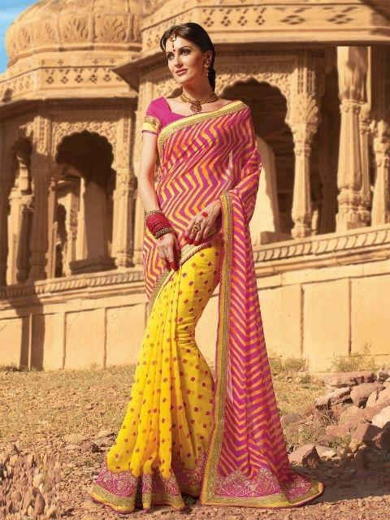


Tips To Take Care of Georgette and Chiffon Sarees

Slide 2
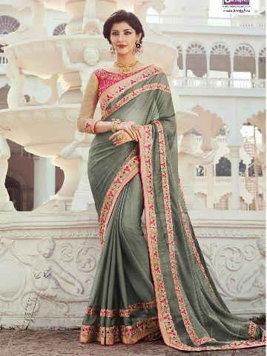
Everyone will have georgette and chiffon sarees in their wardrobe. If you wanted to know how to take care of this fabrics then this is for you.

Slide 3

Georgette is light weight
,dull finished crepe fabric made from silk. Georgette is available in solid colours and prints.

Slide 4
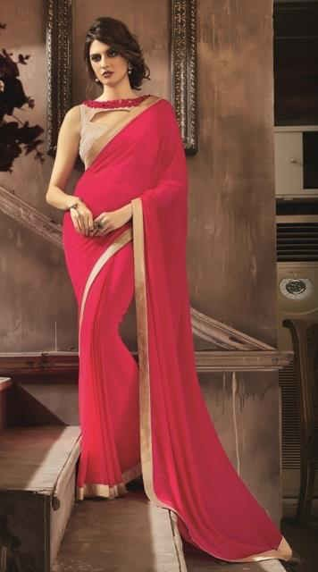
Always prefer hand wash then machine wash
Wash with cold water and mild detergent
Don’t twirl the fabric
while washing
Dry it in shade, air drying is preferable

Slide 5
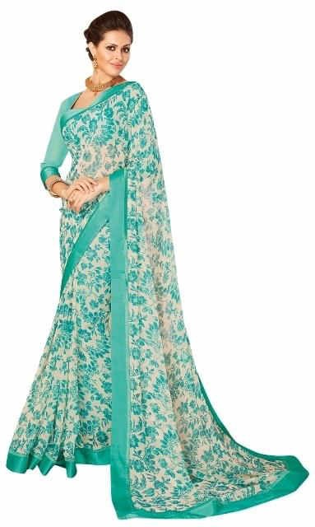
If you are not wearing the saree for too long time they try to refold the saree frequently to avoid ripping of saree. With simple tips and proper care we can extend the life of the fabric

Slide 6
Chiffon is very light and delicate fabric which need special attention.
Usually made from silk, rayon and nylon.

Slide 7

Hand wash in Luke warm water with mild detergent
Preferably wash it alone to avoid sticking of colours of other materials
Don’t Twirl
Avoid Direct Sunlight

Slide 8

Dry Iron is preferable
If anything spilled on the fabric just wipe it with tissue don’t rub it harshly, it may damage the fabric
Refold the fabric if you are not using for long time.

Slide 9
Thank You
www.playppt.com

